Slide 1


CANE
YOUR SIMPLE WAY TO BANK
- TEAM 30 -

Slide 2
Mission Statement
Making Banking Simple For All
We want to inspire developers to focus on simplicity while creating effective BANKING applications to support people with visual impairments

Slide 3

Why?

Slide 4
Improving INCLUSION and DIVERSITY
LACK OF CONSIDERATION for Mobile Banking users with disabilities
20% of the UK population is classed as Disabled, with more than 3.7 million in work
Significant BUSINESS PROFITS, with a major potential user base
350,000 people in the UK registered with visual impairment

Slide 5
Solution

Slide 6
Mobile Application with Gestures for Easy navigation across the app
Core technologies
Android studio
Google maps api
Microsoft Azure
Providing core banking functionalities via a quick and easy structure
Core Features
Speaker recognition
Speech-Text Conversion
Navigation to nearest branch
Account summary
Transactions
Direct Customer support Connection
Voice based login system with User-defined security questions and speaker recognition

Slide 7
Implementation

Slide 8
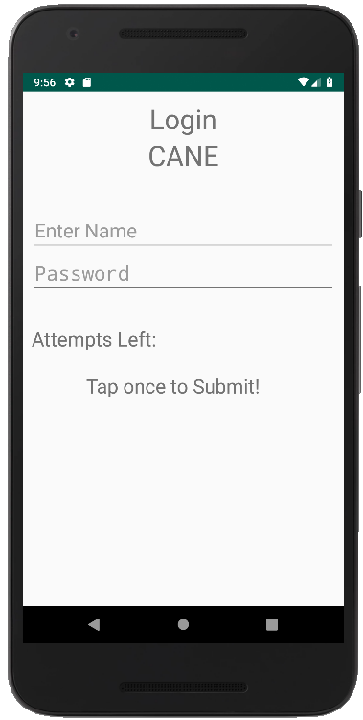
LOGIN
Using Speech-to-Text capabilities and speaker recognition software provided by Microsoft Azure, users will be able to enter their login details by speaking into the application
Using a voice feedback system the application will confirm and instruct the user of any relevant information
The user will have to tap on the screen to submit their login information

Slide 9
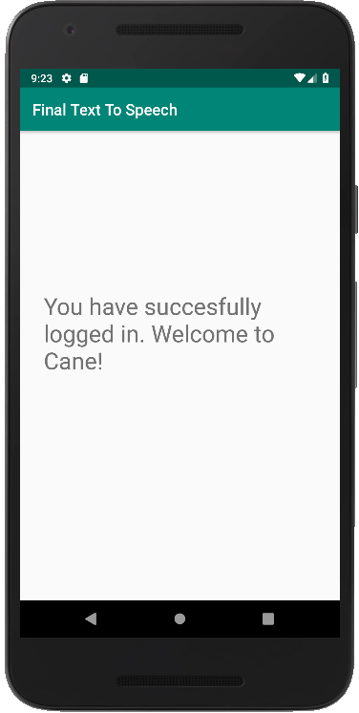
Home
The Home screen will inform the user of their successful login attempt
This screen will automatically transition into the following screens after a certain time:
Account Summary
Transfer Funds
Nearest Branch
Customer Support

Slide 10
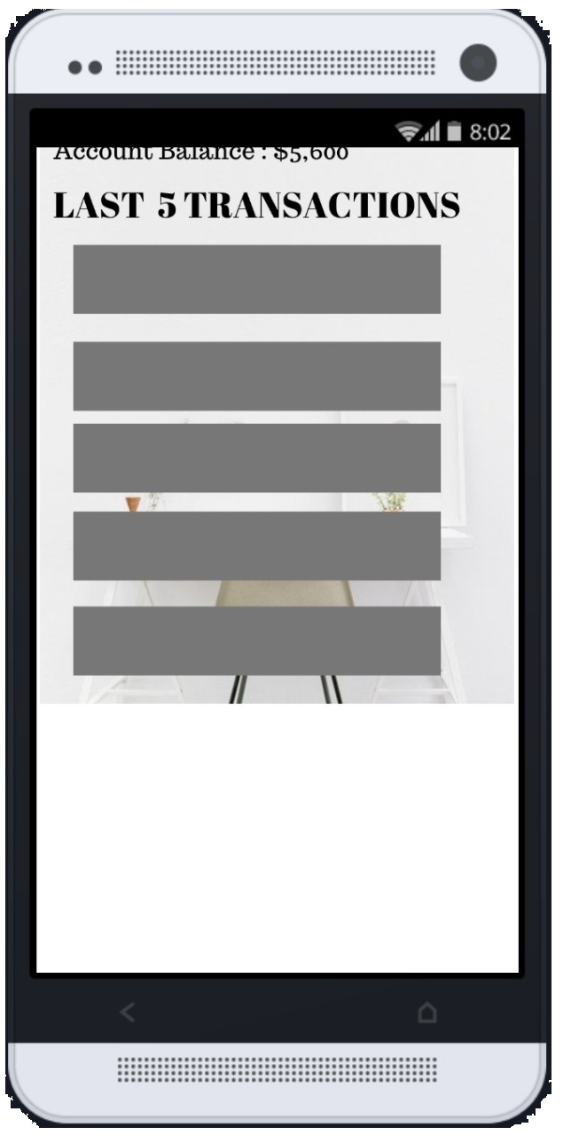
Account Summary
The Account Summary page will display the last five transactions made via the user’s account, along with their account balance and other key information
The navigation to the next or home screen will be via tapping onto the screen

Slide 11
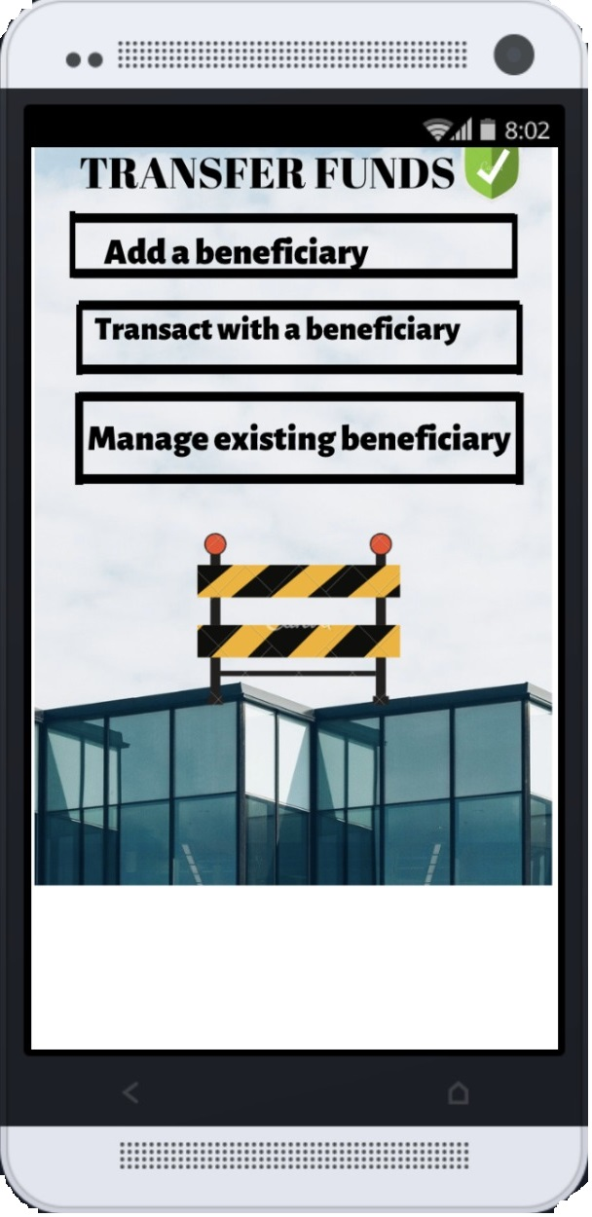
Transfer Funds
The Transfer Funds page allows the user to transfer money to other beneficiaries using a secure mechanism
Core operations permitted are:
Adding new beneficiaries
Transfer funds to existing beneficiaries
Managing/Editing existing beneficiaries
The screen will use Speech-to-Text and vice versa for input and feedback, confirming all relevant details before committing to an operation

Slide 12
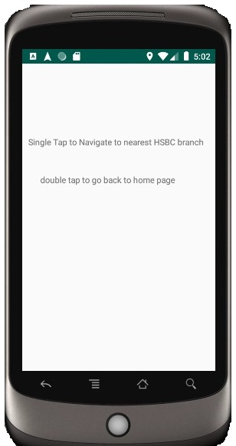
Nearest Branch (1)
The Nearest Branch page allows the user to automatically initiate navigation to their nearest bank branch from a single tap on the screen
Using Google Maps API the application performs a query which retrieves the closest bank branche to the user and begins navigation to this branch

Slide 13
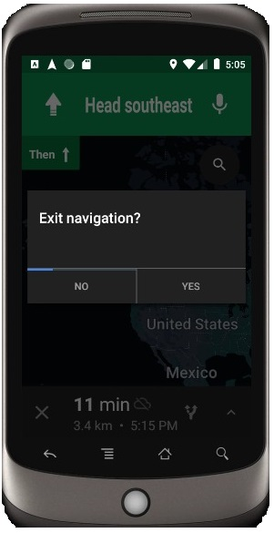
Nearest Branch (2)
Once initiated the user can end navigation at any point
The idea is to allow a voice based navigation to their nearest branch without having to bother with the search and selection operations associated with traditional navigational apps

Slide 14
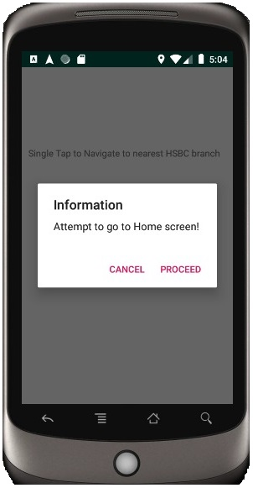
Nearest Branch (3)
If the navigation service is no longer required the user can simply return to the Home screen by double tapping the Nearest Branch screen
This capability is implemented at every screen to allow easy reset
Again confirmation will be required before completing this action and every text will be converted into speech

Slide 15
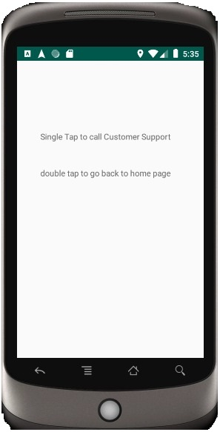
Customer Support (1)
The Customer Support screen enables a quick and simple mechanism to connect to the Bank’s customer support team
The feature will require permission to make calls on behalf of the user
Voice feedback will support this functionality

Slide 16
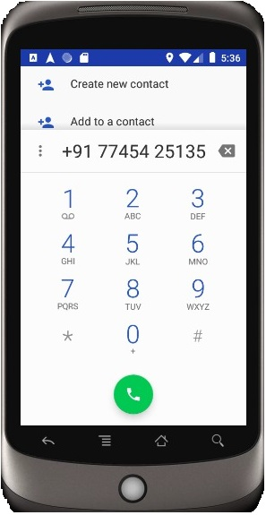
Customer Support (2)
The application connects to the bank’s national helpline from where the user is redirected to the relevant area
The idea is to bypass the hassle of finding the customer support contact details and carrying out the calling action to enable a direct one-tap connection to the customer support

Slide 17
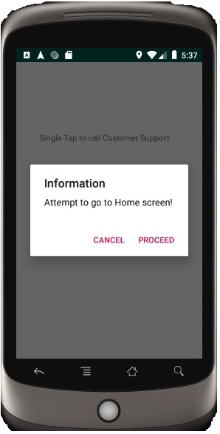
Customer Support (3)
If the customer support service is no longer required the user can simply return to the Home screen by double tapping the Customer Support screen
This capability is implemented at every screen to allow easy reset
Again confirmation will be required before completing this action and every text will be converted into speech

Slide 18
Future development
Our application is a demonstration of how mobile banking operations can become simpler and easier, and there is so much more that can be done…this includes:
Developing a complete Audio-based navigation system
Simplifying the login process, e.g. using biometrics
Implementing additional gestures for greater flexibility
An AI Chatbot to assist any queries automatically

